Slide 1
EE476 Final Project Accumulator
Kendrick Tang, Sung Kim, and Cameron Forbis

Slide 2
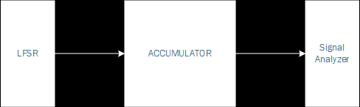
A Problem Statement
Build an accumulator that outputs sum of 64, 16 bit sign magnitude numbers in 22 bit twos complement format
Create built in self test unit using a 16 bit LFSR and 22 bit signal analyzer
Size design to drive 20fF load on outputs

Slide 3
Approach
LFSR
User Input
Use an adder and a partial sum register to accumulate a sum
Use a output register clocked every 64 cycles to store the output
Use a counter to clock the output register and reset the partial sums
Use muxes to switch between test IO and real IO.
+
Partial Sum Register
Output Register
Counter

Slide 4
A Design Flow
Identify components needed for the accumulator
Design components (adder, counter, FF, …)
Design top level integration
Perform simple tests on individual components
Perform a robust test on the accumulator
Layout
If time permits, optimize

Slide 5
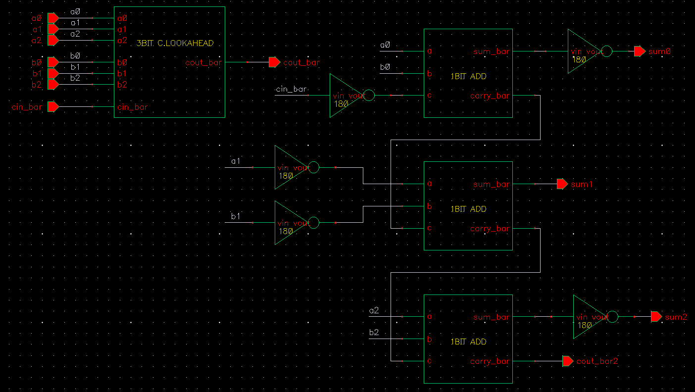
Adder Design
Carry look-ahead design
3 bit ripple-carry adders
Propagate, generate logic is formed with a single complex gate + nands/nors to get Pi_bar and Gi_bar

Slide 6
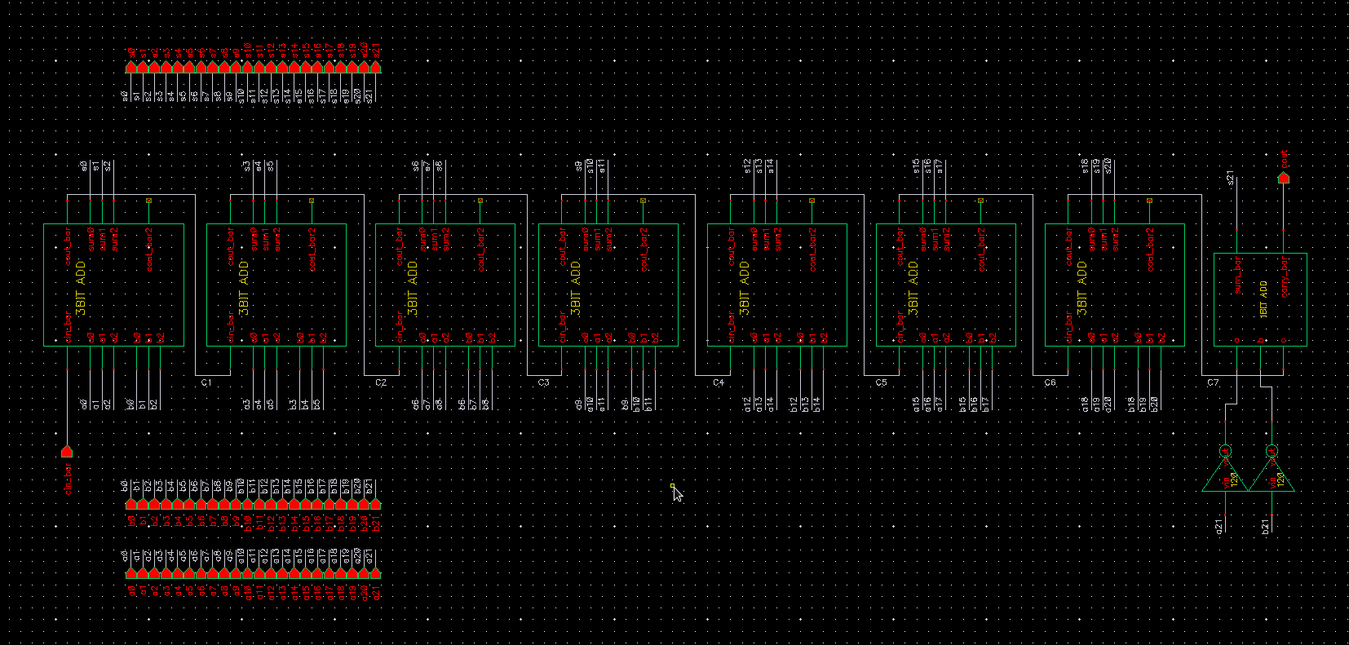
A 22-bit adder

Slide 7
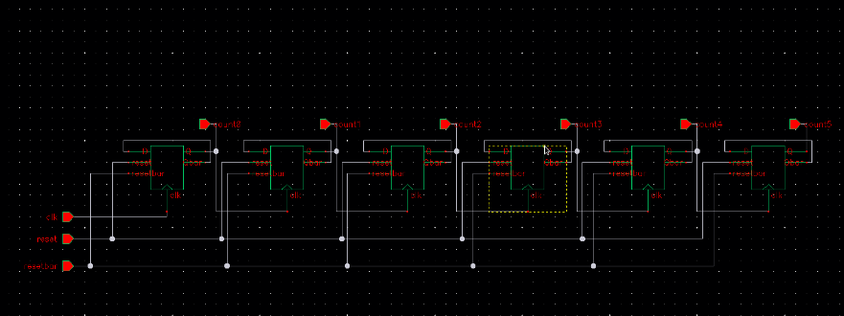
A Ripple Counter

Slide 8
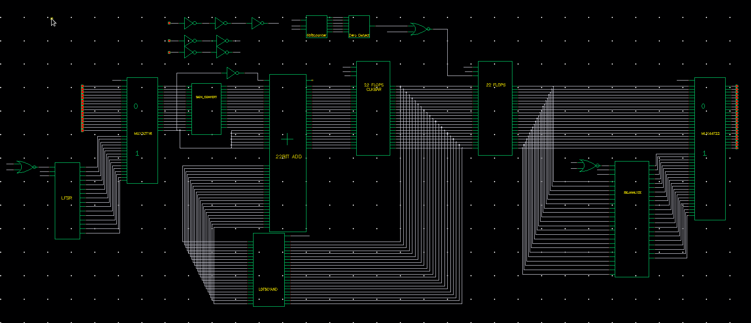
Accumulator

Slide 9
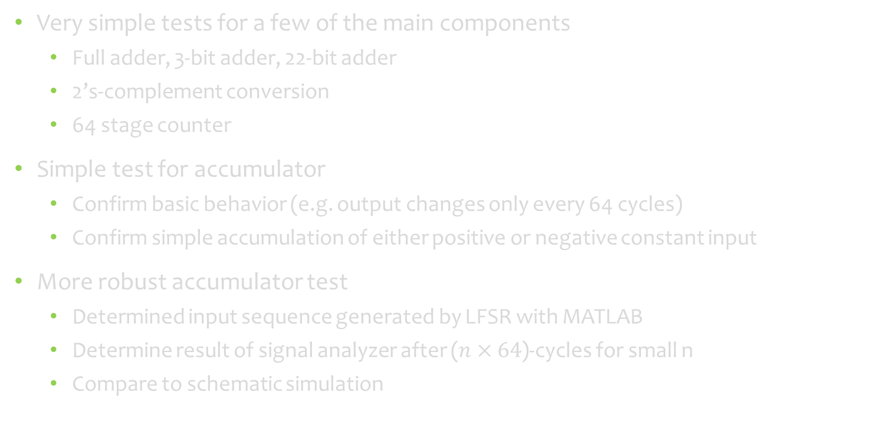
A Validation Method
Very simple tests for a few of the main components
Full adder, 3-bit adder, 22-bit adder
2’s-complement conversion
64 stage counter
Simple test for accumulator
Confirm basic behavior (e.g. output changes only every 64 cycles)
Confirm simple accumulation of either positive or negative constant input
More robust accumulator test
Determined input sequence generated by LFSR with MATLAB
Determine result of signal analyzer after ($n×64$)-cycles for small n
Compare to schematic simulation

Slide 10
An Update
What is done:
Built simulators in MATLAB
Confirmed schematic
Layout complete of most simple cells
What is left:
Finish the adder layout
Finish layout of higher level components (registers, counters, LFSR, 22-bit adder, …)
Wire the top level together
If time permits, optimize
Write report

